Slide 1

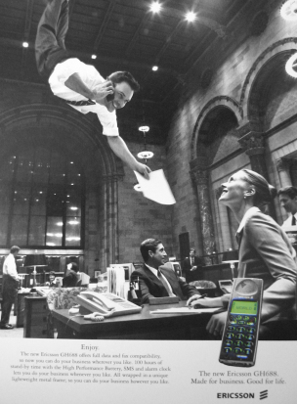
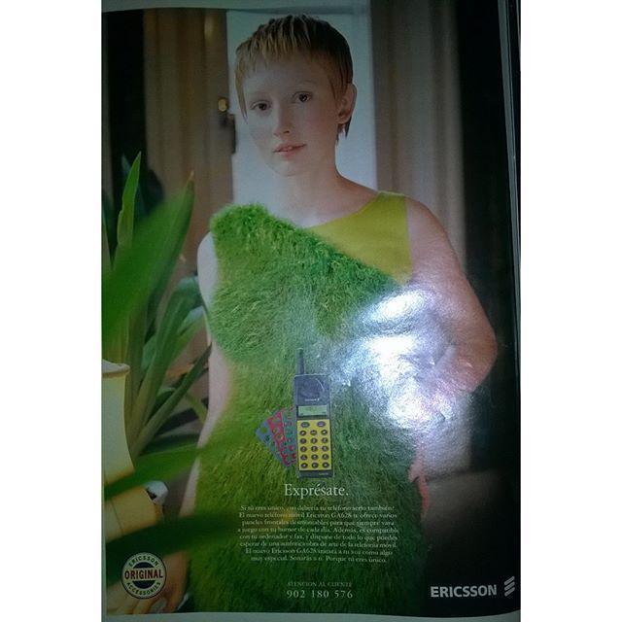

Mobil készülékek
Wagner Tibor
Notes:
Key message: The same feedback is consistent from all operators that there are at least three areas they need to succeed with:
Relentless efficiency – it is table stakes that the operators need to be more efficient, basically lower $ per Gigabyte.
E.g. Converging and radically simplified IT- & network environments, automation of operations
Customer experience – today’s customers expect a much more simple, flexible and faster experience. This is a key competitive advantage but often hard to do well due to complex legacy environments. The aim with digitalization is today often to facilitate empowered customers with personalized services and pro-active self-care, agile service creation and zero-touch automation from provisioning to assurance and insight based marketing & value growth
- E.g. Customer experience meeting or exceeding the bar set by today’s top digital retailer
New revenue streams – over the past few years growth has flattened out and traditional services do not generate the same returns as it once did. However, new usage related to IoT and industry digitalization in combination with network capabilities such as 5G open up new opportunities
- E.g. New services enabled by new network capabilities, e.g. network slicing and distributed cloud
Leverage technology advances – The winner in this highly competitive market will be the one that can best utilize the opportunities related to technology trends mentioned in the previous slide both for efficiency as well as for new services and revenues. The trends are related to AI, Automation, Cloud, Programmable networks and Full mobility.
Acronyms: VoLTE = Voice over LTE = Voice over Long Term Evolution. IoT = Internet of Things. EB = Exabyte
Customers looking to drive value creation in three key areas

Slide 2

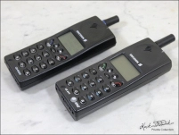

1998: GH688

Slide 3
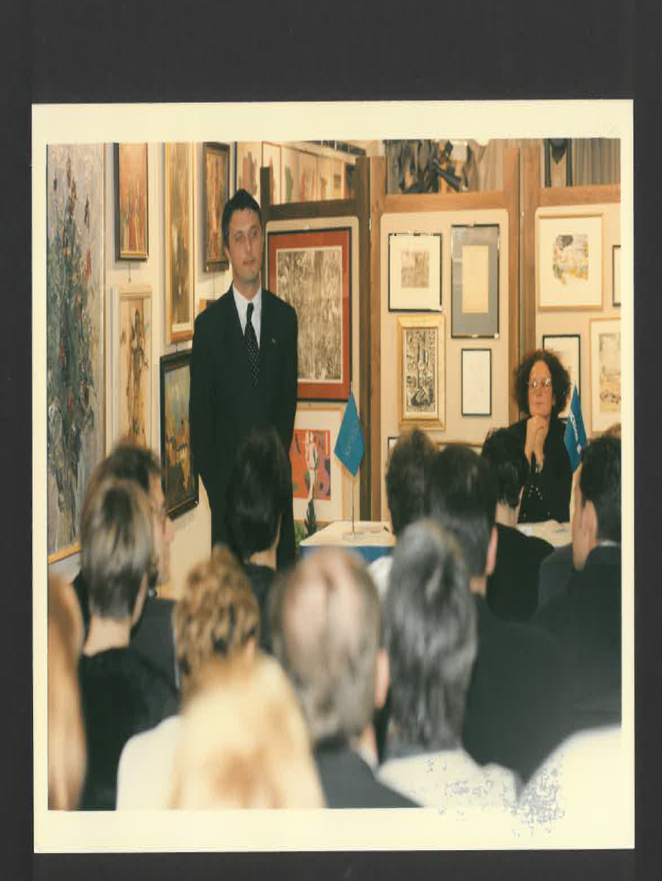
A belépőm...

Slide 4

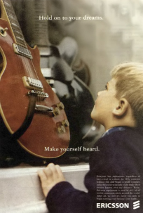
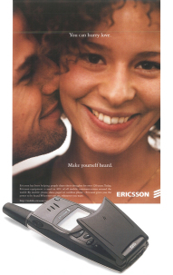
Make yourself heard

Slide 5
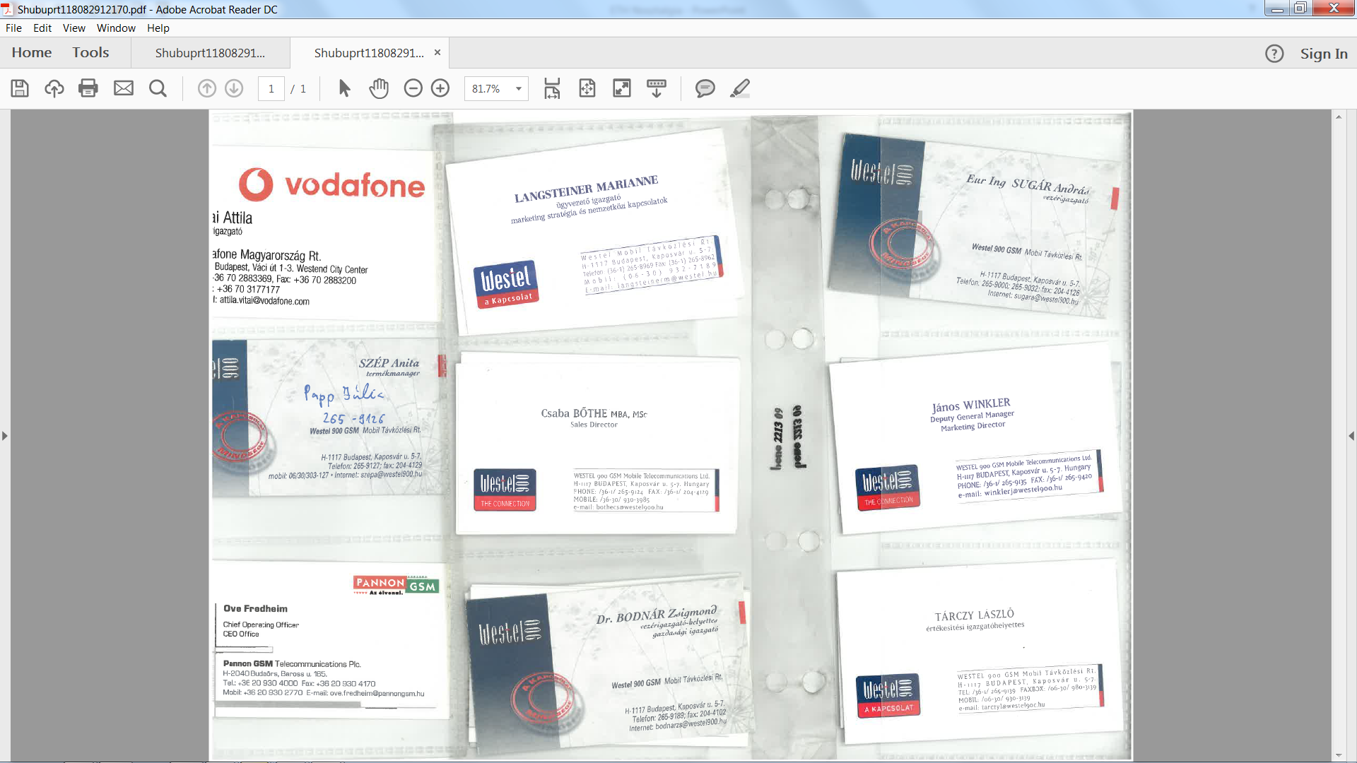

Slide 6
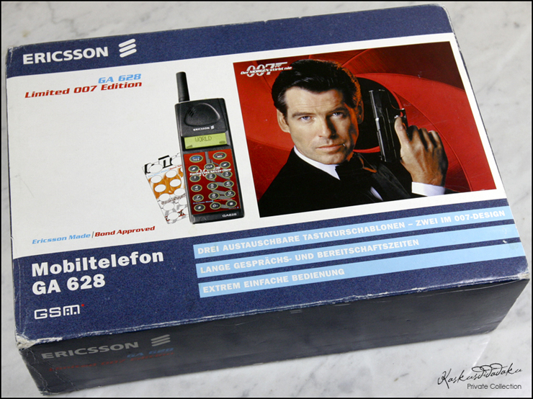
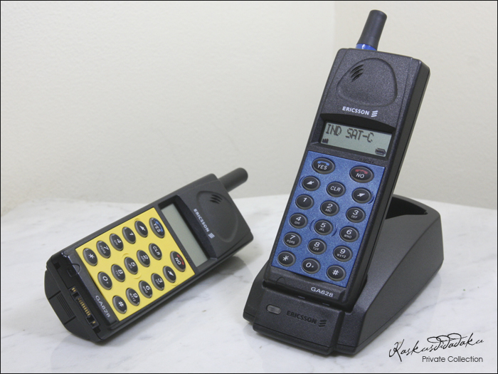
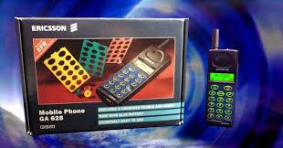

Slide 7
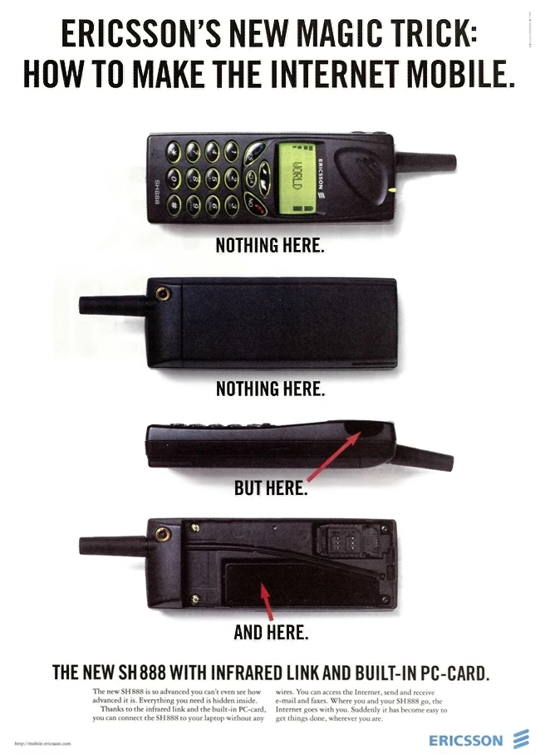
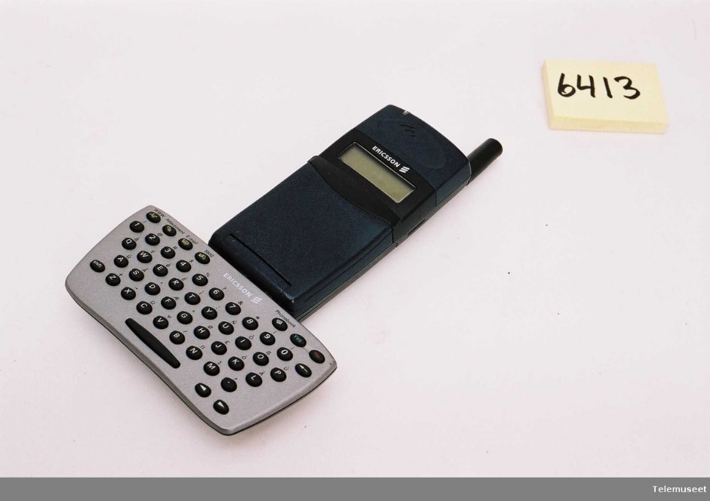

Slide 9
Félmillió Westel 900 előfizető

Slide 10
Westel- Ericsson Team

Slide 11
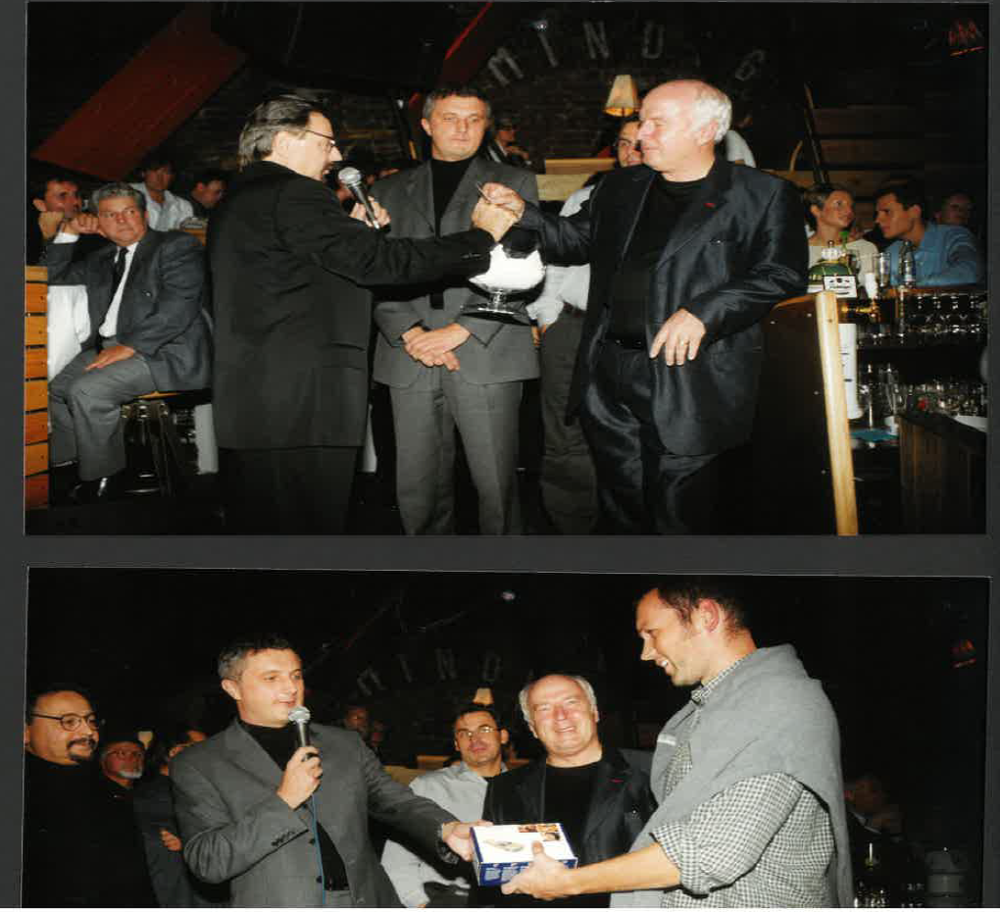
Jazz koncertek

Slide 12
Márkabolt megnyitó
IFABO

Slide 13
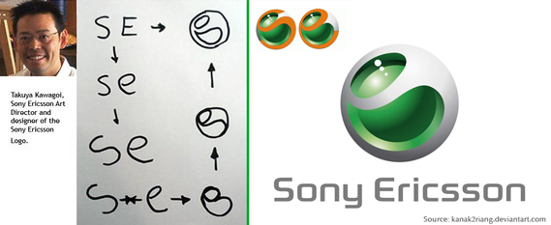

Slide 14
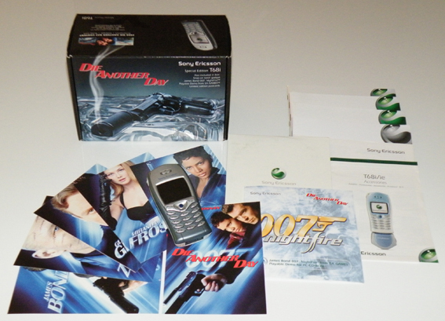

Slide 15
