Slide 2
Az Ericsson Magyarország első negyedszázada
Fodor István
Notes:
Key message: The same feedback is consistent from all operators that there are at least three areas they need to succeed with:
Relentless efficiency – it is table stakes that the operators need to be more efficient, basically lower $ per Gigabyte.
E.g. Converging and radically simplified IT- & network environments, automation of operations
Customer experience – today’s customers expect a much more simple, flexible and faster experience. This is a key competitive advantage but often hard to do well due to complex legacy environments. The aim with digitalization is today often to facilitate empowered customers with personalized services and pro-active self-care, agile service creation and zero-touch automation from provisioning to assurance and insight based marketing & value growth
- E.g. Customer experience meeting or exceeding the bar set by today’s top digital retailer
New revenue streams – over the past few years growth has flattened out and traditional services do not generate the same returns as it once did. However, new usage related to IoT and industry digitalization in combination with network capabilities such as 5G open up new opportunities
- E.g. New services enabled by new network capabilities, e.g. network slicing and distributed cloud
Leverage technology advances – The winner in this highly competitive market will be the one that can best utilize the opportunities related to technology trends mentioned in the previous slide both for efficiency as well as for new services and revenues. The trends are related to AI, Automation, Cloud, Programmable networks and Full mobility.
Acronyms: VoLTE = Voice over LTE = Voice over Long Term Evolution. IoT = Internet of Things. EB = Exabyte
Customers looking to drive value creation in three key areas

Slide 3
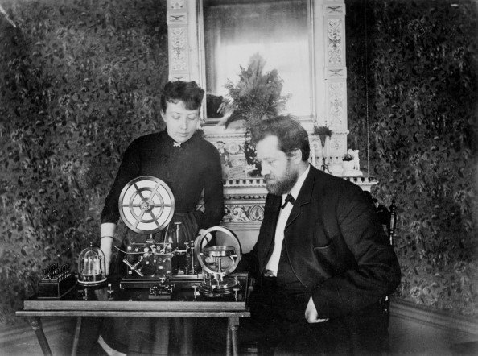
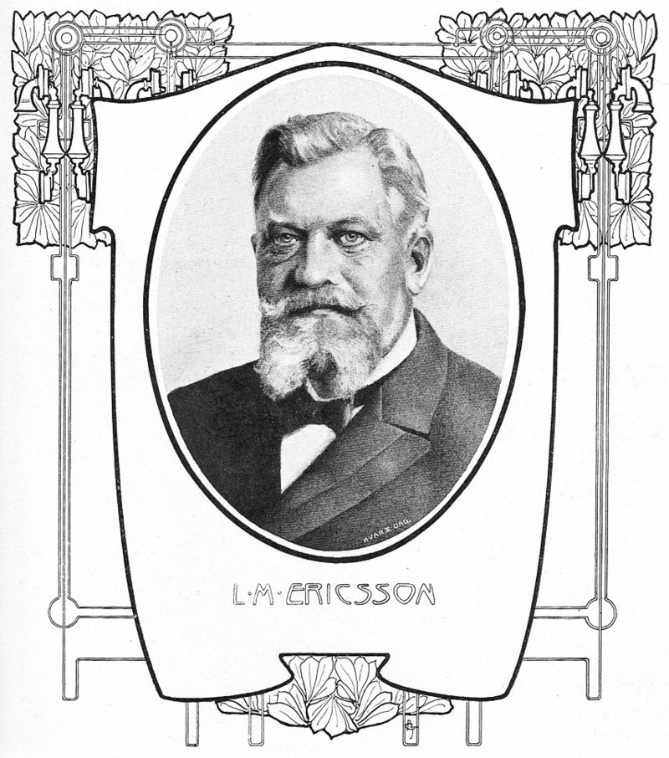
Lars Magnus Ericsson (1846 – 1926)

Slide 4
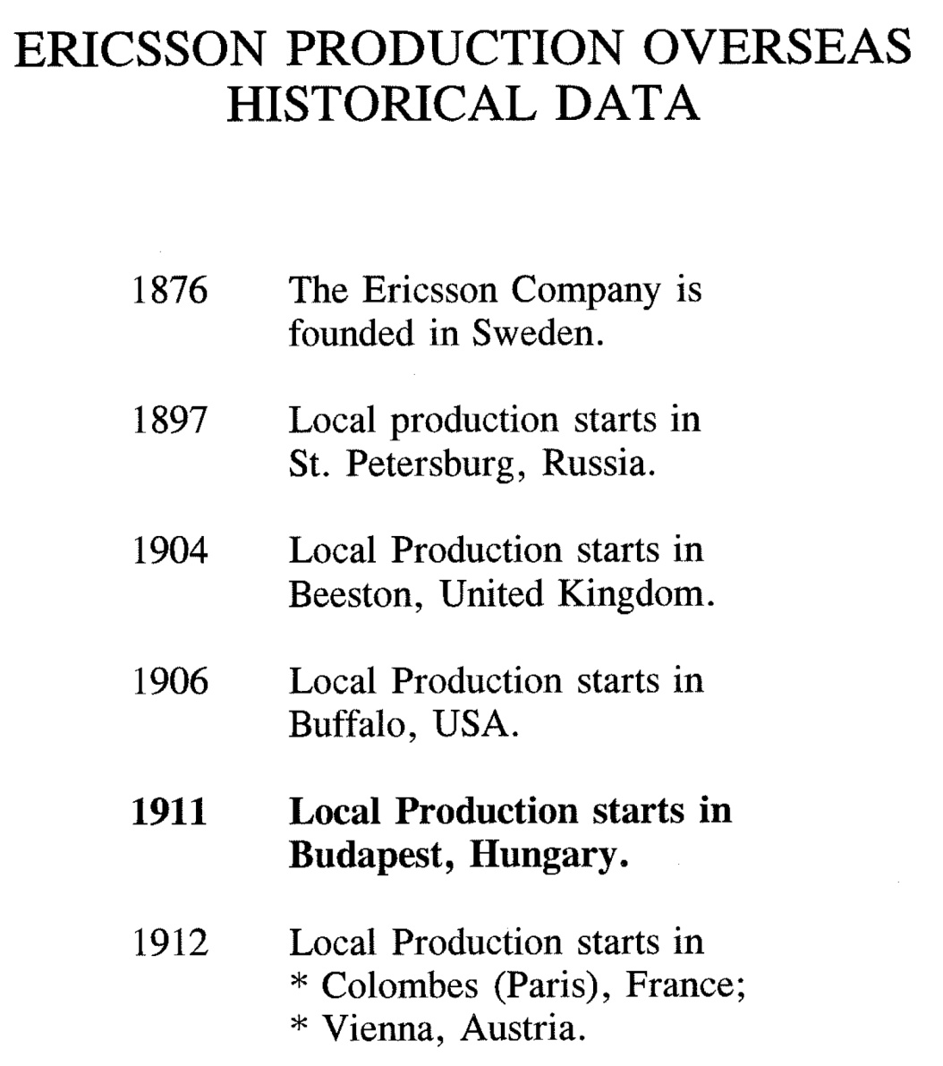
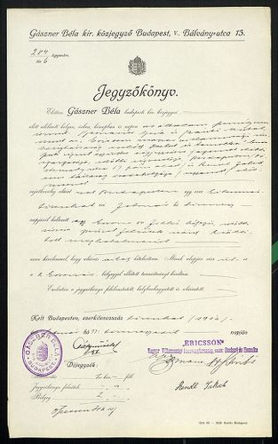
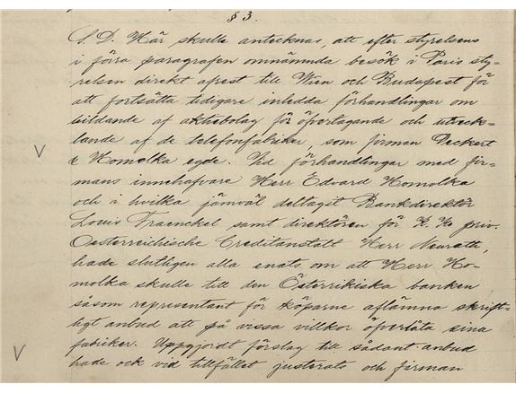
1911 novembere - megalakul a magyar Ericsson

Slide 5
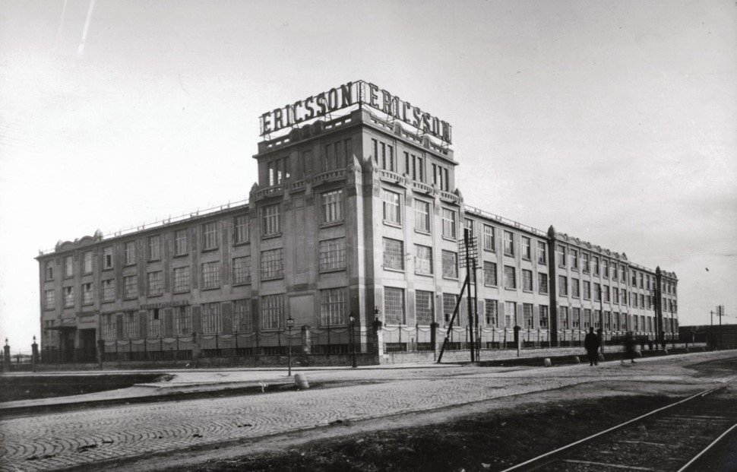
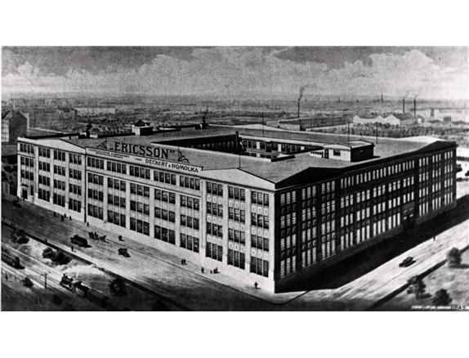
Fehérvári út 70.

Slide 6
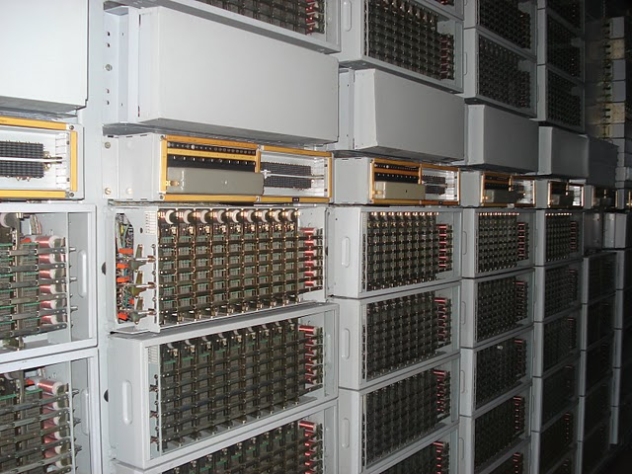
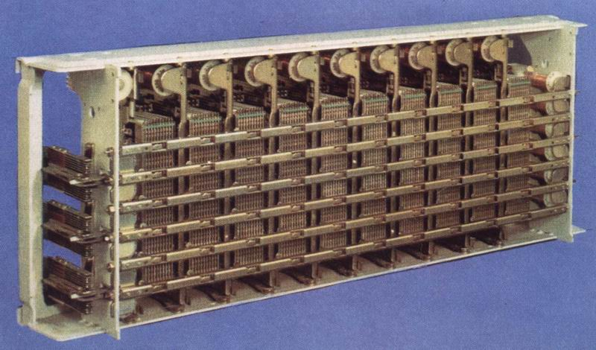
Crossbar központ

Slide 7
1987, indul a telefon digitalízálációja a MATÁV-nál, miközben COCOM tiltás van.
Az induló tenderből kitiltják az Ericssont COCOM tiltásra hivatkozva, ami teljesen indokolatlan.
Nyer a Northen Telecom (Kanada), 350 dollár/vonal, a processzort csak a COCOM tiltás után szállítják

Slide 8
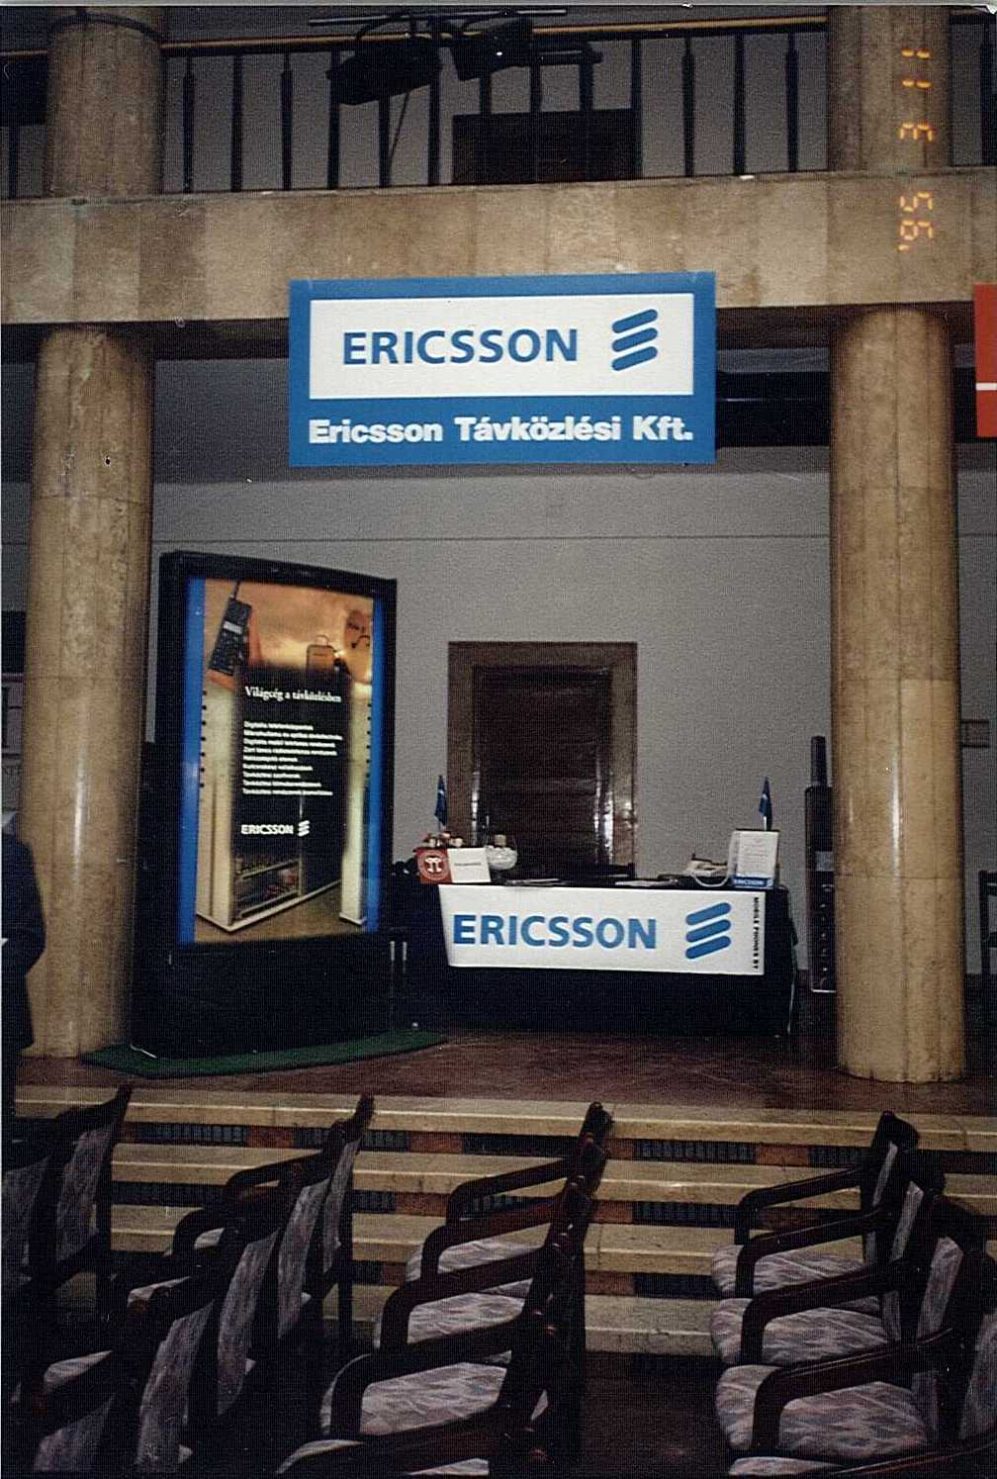
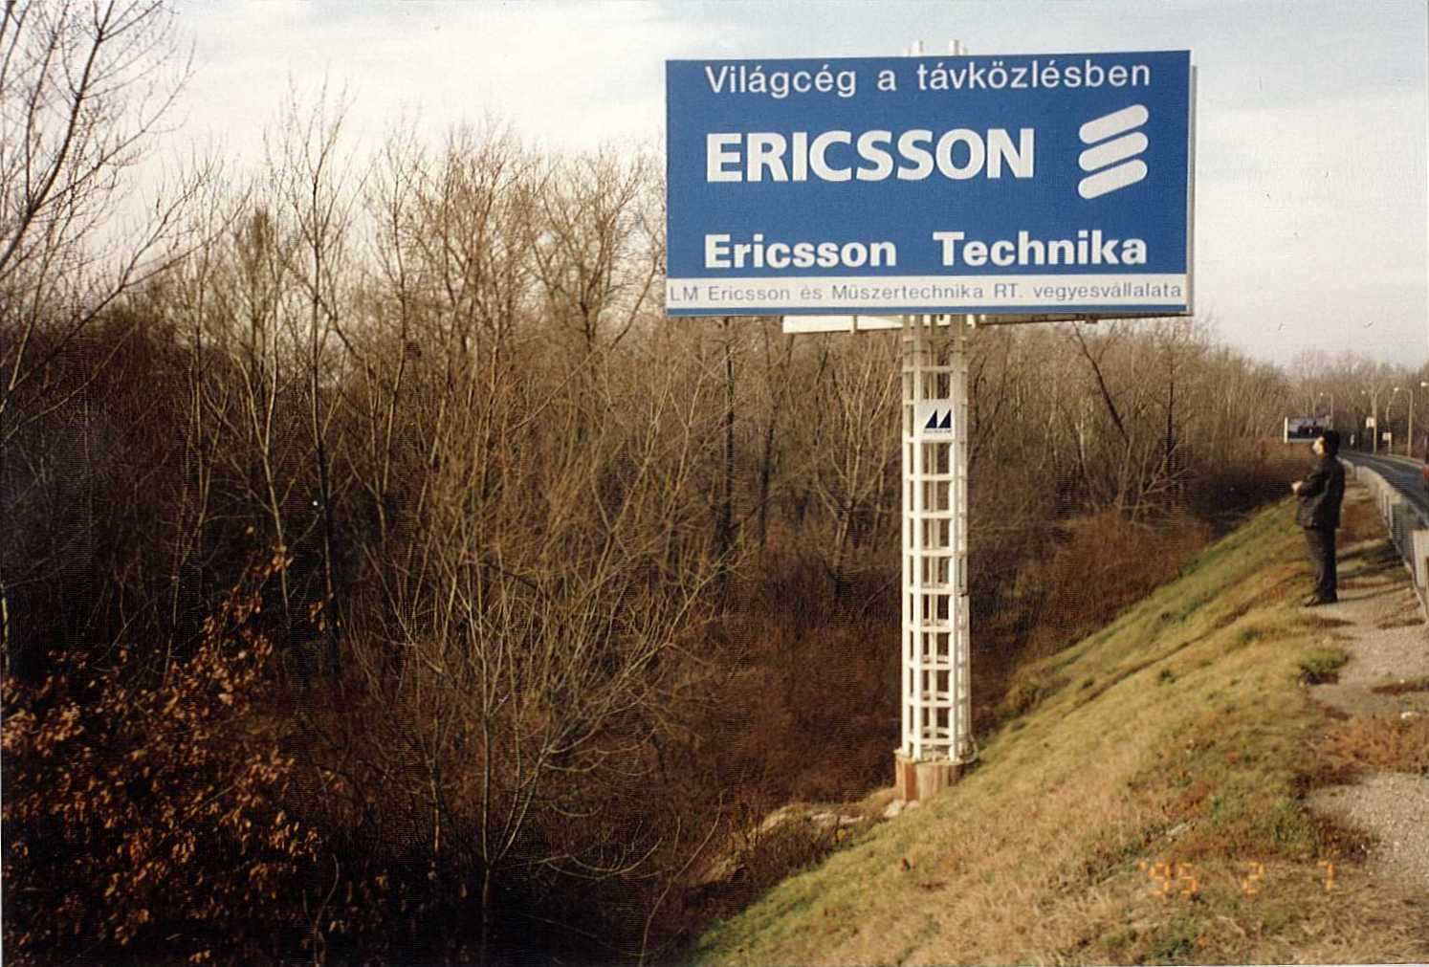
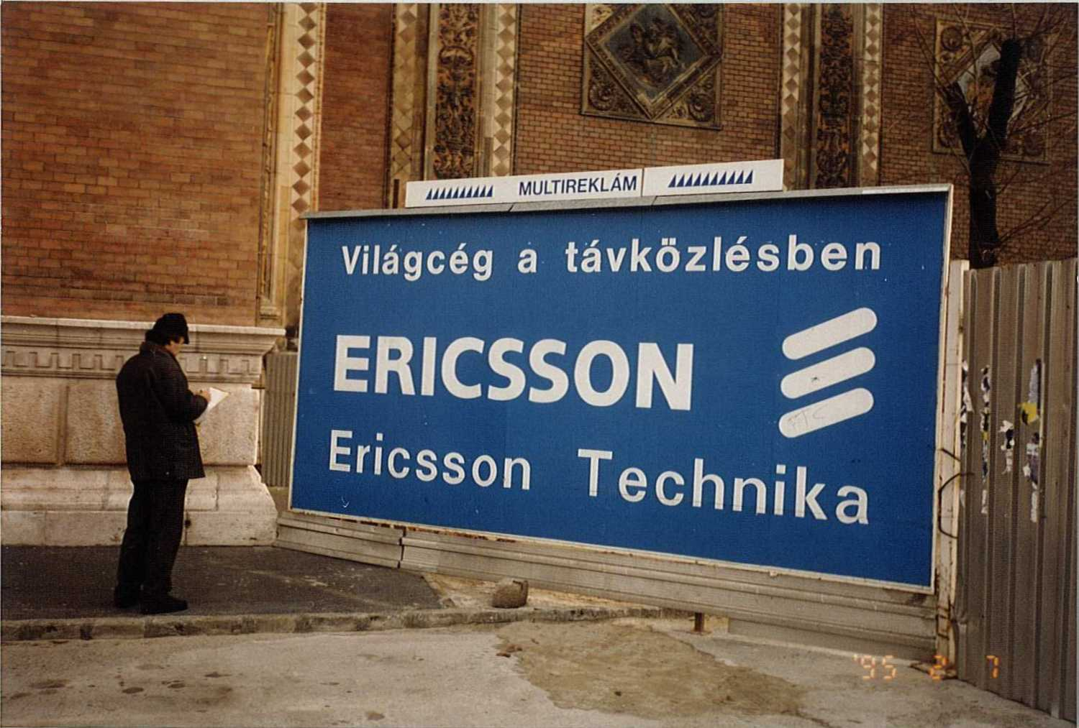
1990. december 5.

Slide 9
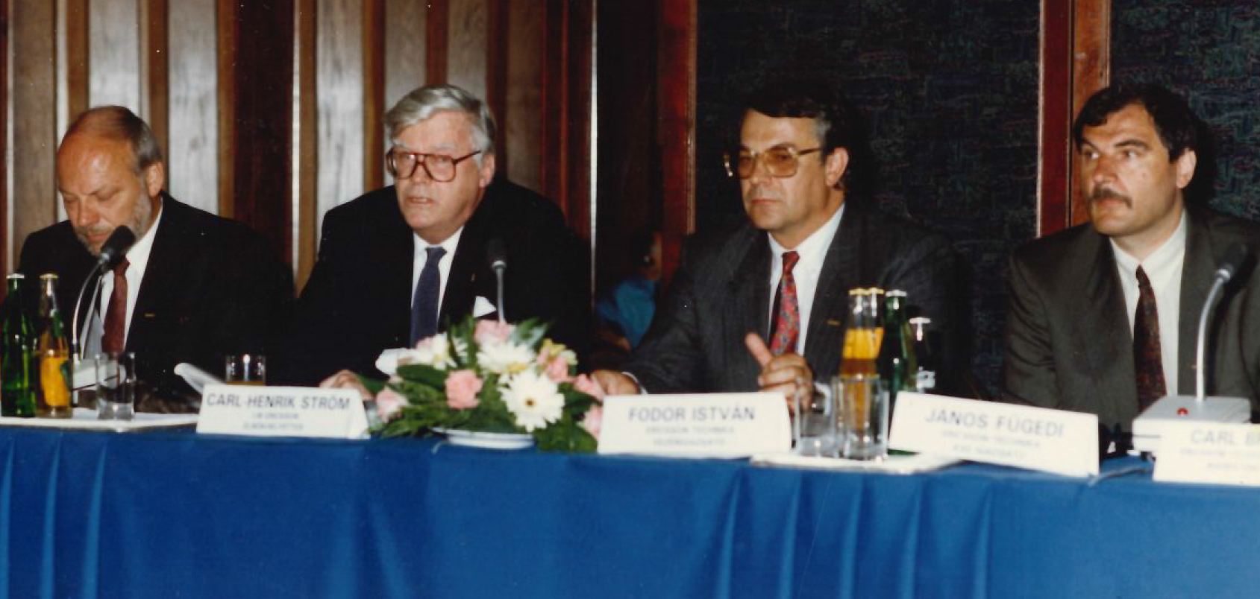
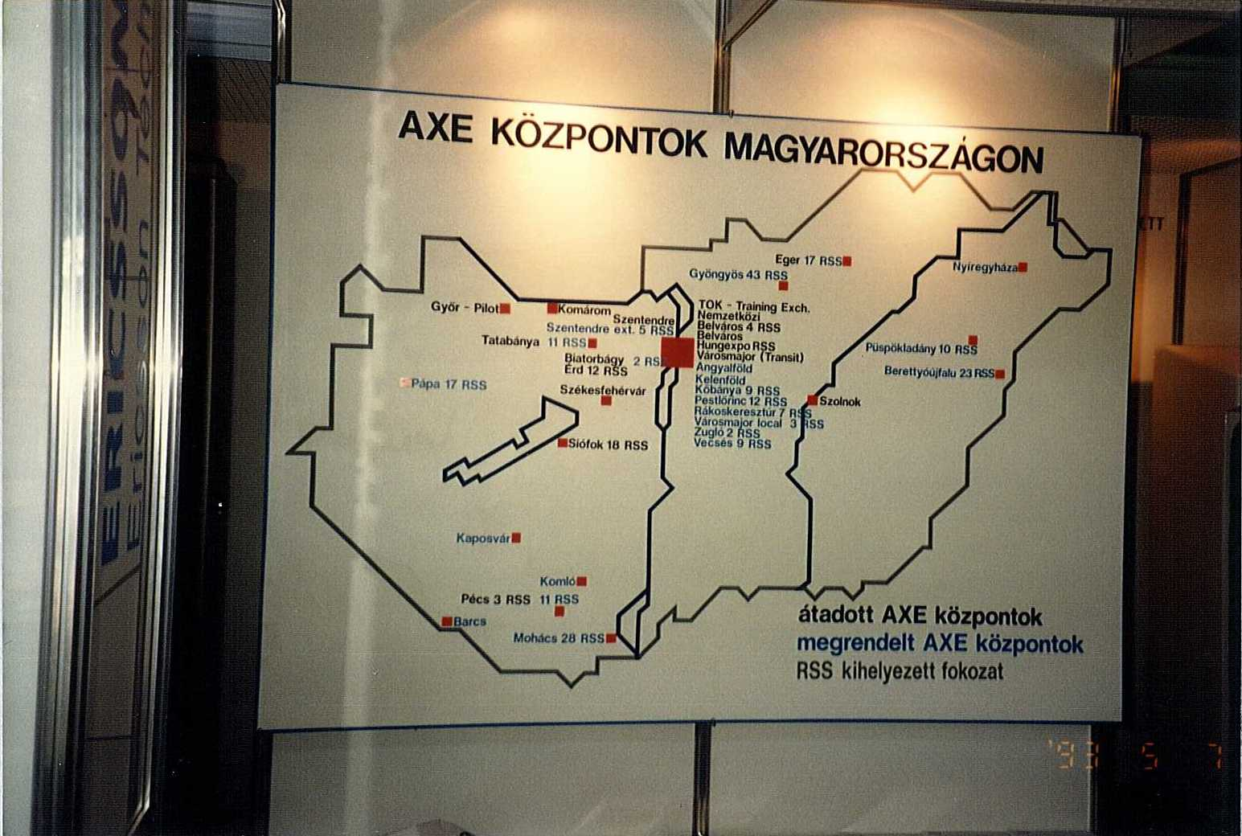
Az indulás – AXE
ETH Története konferencia

Slide 10
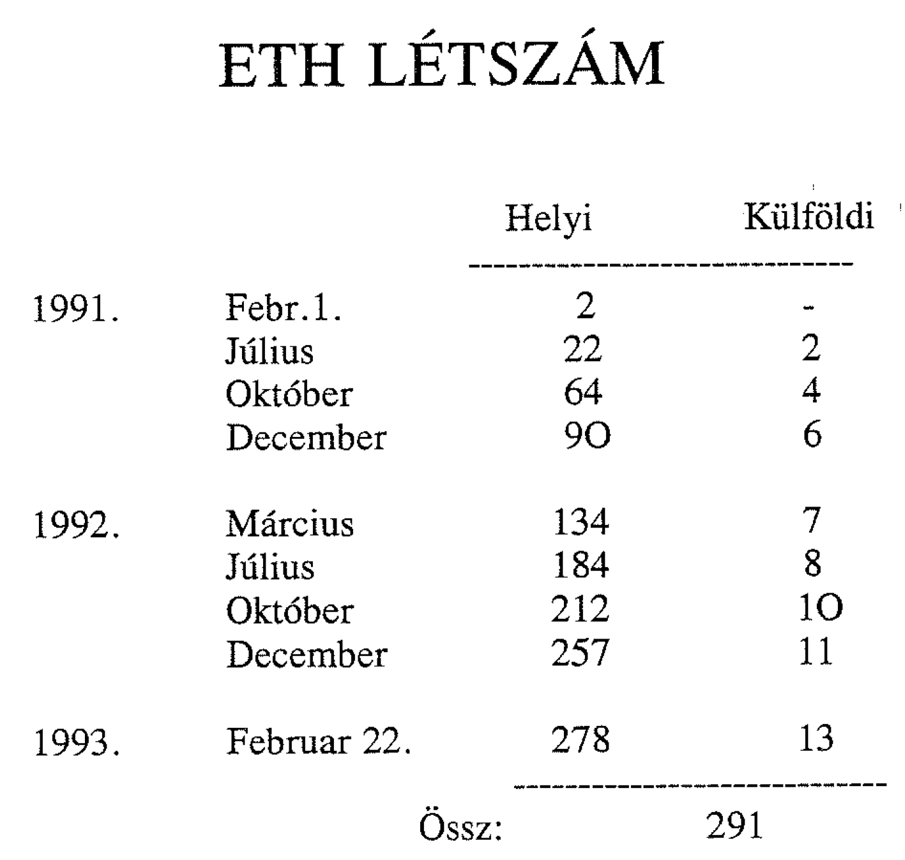

Slide 11
Az Ericsson értékei
professzionalizmus
tisztelet
kitartás
+
tisztesség

Slide 12
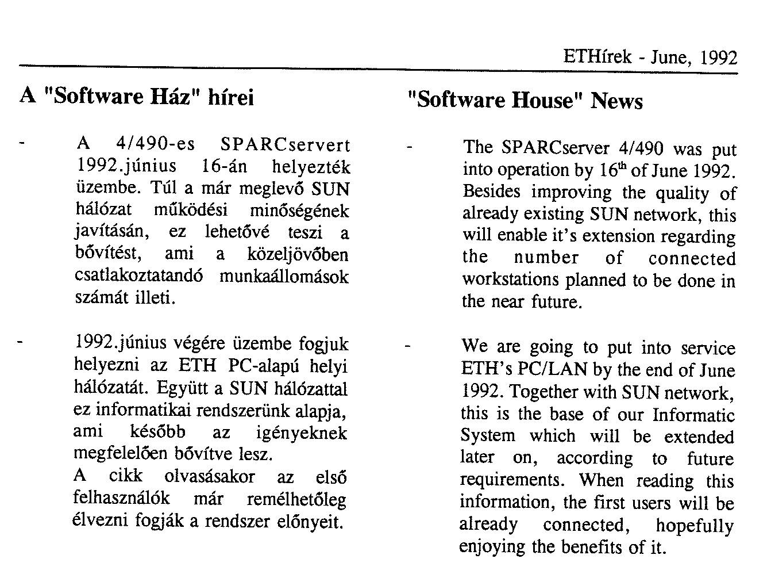
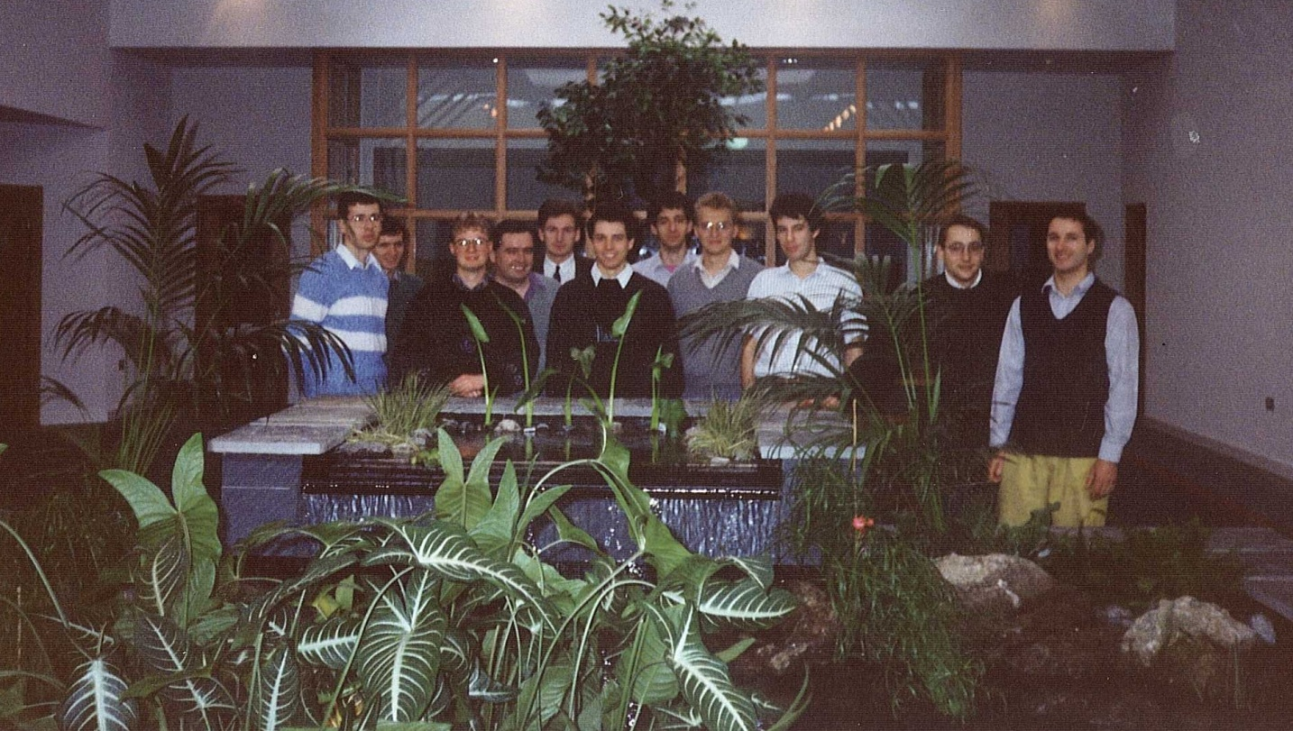
A szoftverosztály

Slide 13
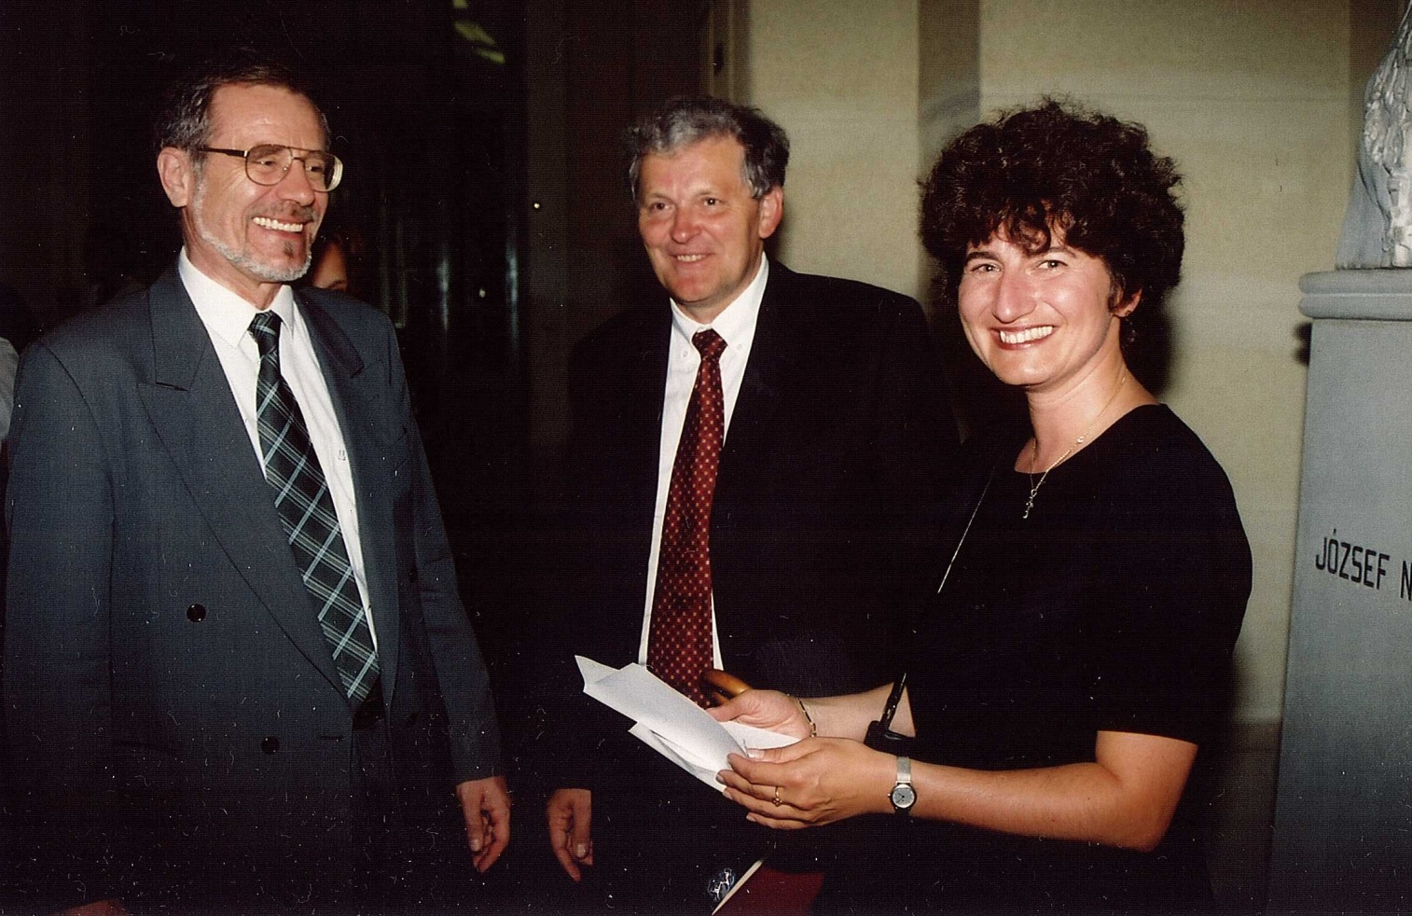
1993 – ban Ericsson Lab. a Műegyetemen
1995 – ban HSN Lab. a Műegyetemen
Majd laboratórium létesül az ELTE –n.

Slide 14
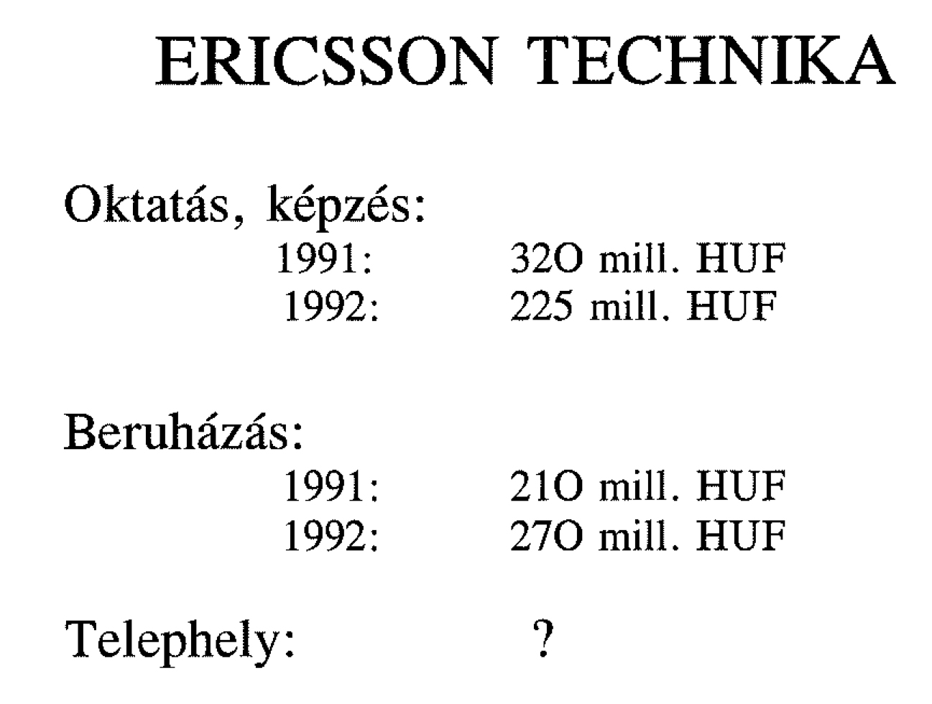
Oktatási és beruházási költségek az első években

Slide 15
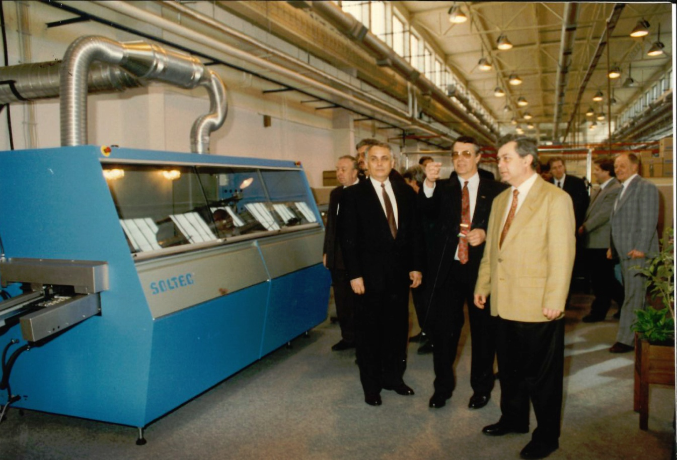
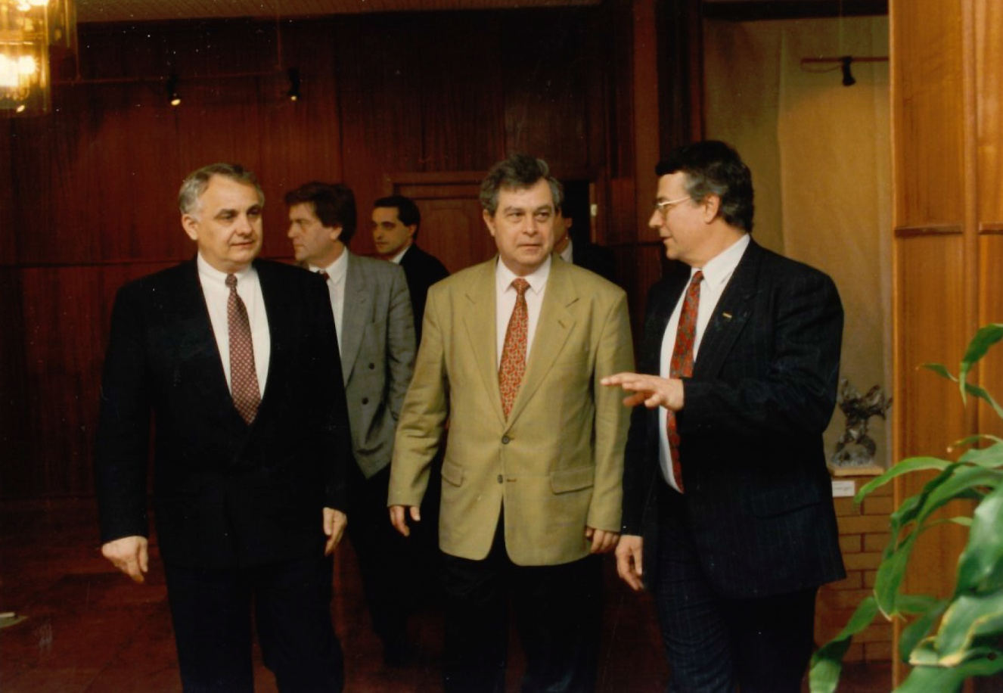
A gyártás

Slide 16
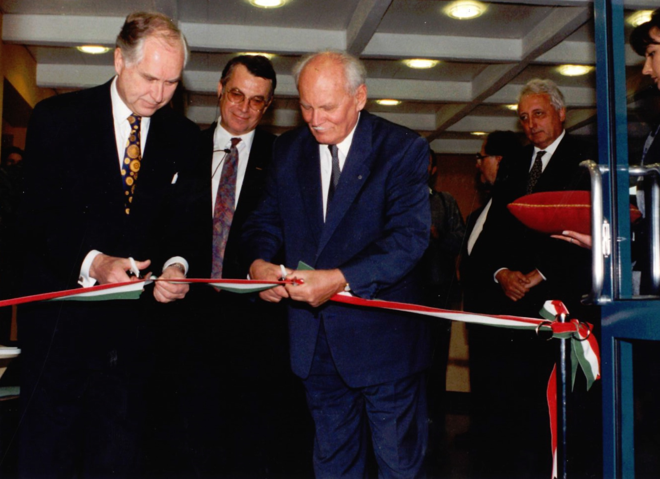
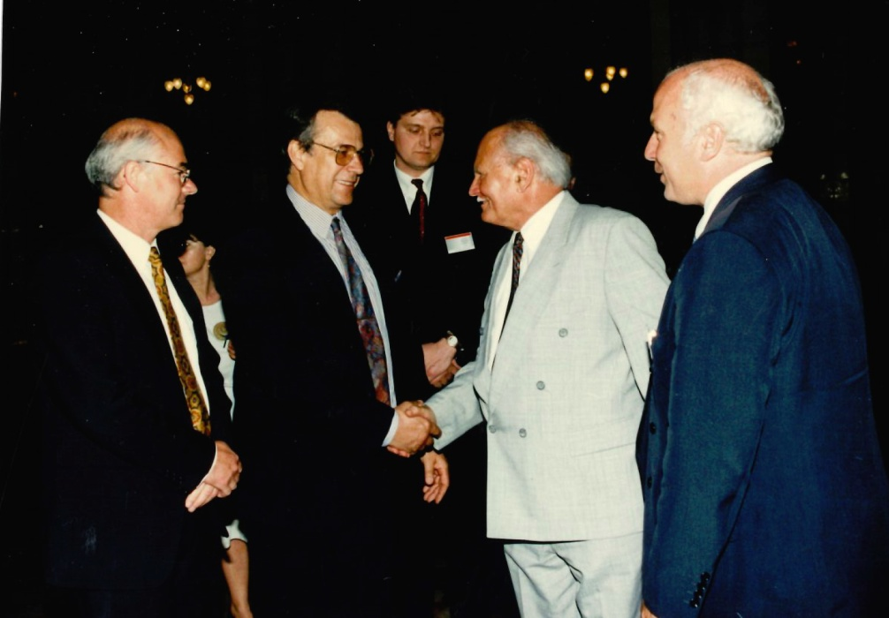
Székházavató – III. Laborc u. 1.

