Slide 1
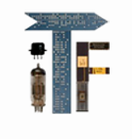
John von Neumann in Computer Science
Balint Domolki
Honorary President of the John von Neumann Computer Society
The 2016 IEEE International Conference on Systems, Man, and Cybernetics
Panel dedicated to John von Neumann “a Pioneer of Modern Computer Science”

Slide 2
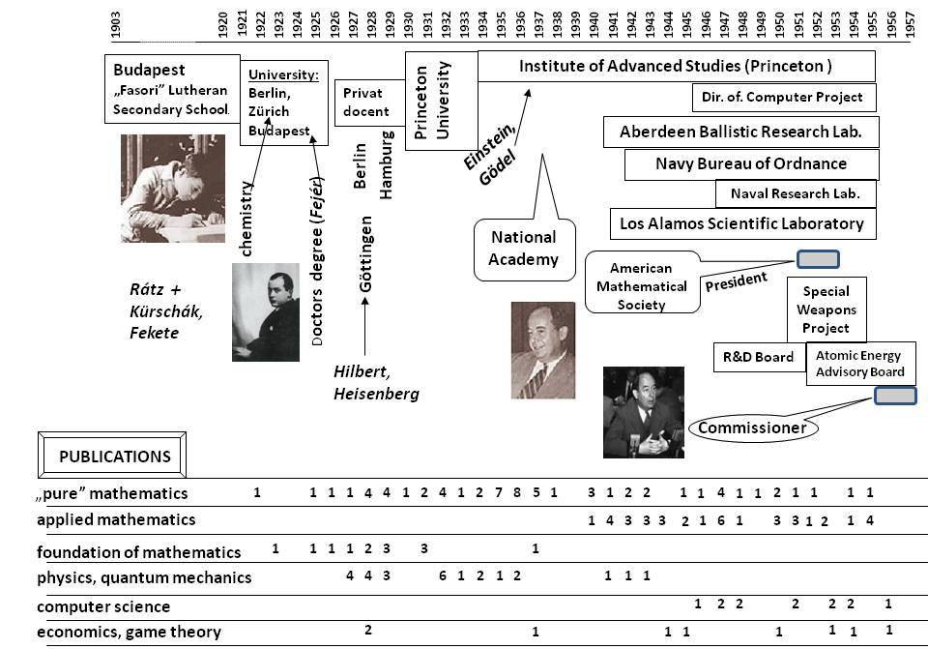
John von Neumann (1903-1957)

Slide 3
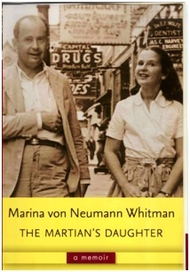
Three periods
Study (1903-26)
Budapest, Berlin, Zurich
„Ivory tower” (1927-38)
Berlin, Hamburg, Gottingen → Princeton
„Man of action” (1939-57)
Princeton, Los Alamos, …. Washington
Marina von Neumann.Whitman:
"...my father led a double life: as a commanding figure in the ivory tower of pure science, and as a man of action, in constant demand as an advisor, consultant and decision-maker in the long struggle to insure that the United States would be triumphant in both the hot and the cold wars that together dominated the half century from 1939 until 1989."

Slide 4
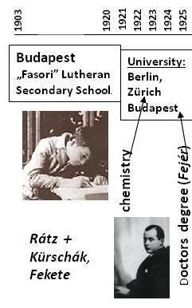
I. Study
Rich banker family, received nobility patent in 1913 („von…”)
Early talent (not only in math)
„Fasor” Lutheran Gymnasium (also: Wigner, Harsanyi)
Excellent math. teacher: Laszlo Ratz (award for secondary school teachers!)
Tutoring by TU professors
Publication at age of 19, together with Prof. Fekete
Studying chemistry in Berlin, Zurich, plus mathematics in Budapest

Slide 5
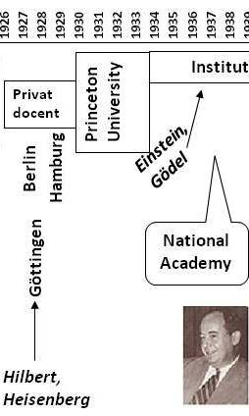
II: „Ivory tower”
Teaching at Univ. Berlin (1926-28) and Hamburg (1929-30)
Fellowship to Gottingen, meeting Hilbert, Heisenberg
Leaving for US in 1930: Princeton Univ.
„Founding member” of the Institute for Advanced Studies (IAS), together with Einstein and Gödel
Leading US mathematician with high international reputation, member of US National Academy.
US citizenship in 1937 -> start of military oriented activities
IAS

Slide 6
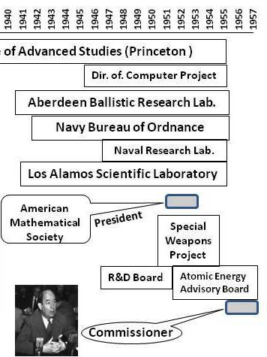
III. „Man of action”
Advisor to several military institutions
Manhattan Project –> Atomic Energy Commission
motivation:
to help his new homeland again nacism and communism in WW-II and the Cold War
scientific interest:
theory of explosions, shock waves (-> atomic bomb)
game theory (->military strategy)
plus: „general problem solving wizard”
loss to pure science
„Although he remained on the faculty of IAS until 1955, the contemplation of pure mathematics… was pushed aside by his involvement in crucial issues relating to the security of the United States to the dismay of his mathematics colleagues”

Slide 7
Publications
pure mathematics was present all over his life
the 20s-30s dominated by physics (mainly quantum mechanics) and the foundation of mathematics, while in
the 40s-50s many publications on applied mathematics and computer science can be found
after a few initial publications in the 20s, topics of ecomomics (mainly theory of games) flourished in the 40-50s

Slide 8
Computing
Last decade of his life
„Man of action” period
Earlier no interest:
1937: letter of recommendation to Alan Turing not mentioning his paper on computing!
Regarded mainly as tool for scientific research
Explosion theory, shock wawes….
Los Alamos → Aberdeen
Stanislav Ulam:
„ His work, from the beginnings of the Second World War, concerns a study of the equations of hydrodynamics and the theory of shocks. The phenomena described by these non-linear equations are baffling analytically and defy even qualitative insight by present methods. Numerical work seemed to him the most promising way to obtain a feeling for the behaviour of such systems. This impelled him to study new possibilities of computation on electronic machines ..”
ENIAC: electronic computer being built for artillery table calculations

Slide 9
Genesis of the digital computer
1935
1936
1937
1938
1939
1940
1941
1942
1943
1944
1945
1946
1947
1948
1949
1950
1951
1952
1953
1954
1955
1956
1957
1958
Konrad Zuse, D (Z1) (Z2) (Z3) (Z4) (Z5) (Z11) Z22 Z23
Bell Lab:
(Stibitz CNC)
LANDMARKS:
Z3 – 1941
stored proram
electromagnetic
ABC -1942
electronic
special purpose
ENIAC – 1946
electronic
universal
EDVAC/EDSAC -1949
electronic
stored program
Harvard/IBM:
(Aiken Mark 1)
Atanasoff: ABC
Neumann visits ENIAC
Iowa Univ.:
Mauchly Eckert:
ENIAC
Moore School Pennsylvania/
Ballistic.Res.Lab Aberdeen
UNIVAC
…+ Neumann:
EDVAC
IAS, Princeton:
Neumann: IAS
First draft….
Cambridge, UK
Wilkes:
EDSAC
Manchester, UK
Williams:
„Baby” Mark1
IAS derivatives all over the world

Slide 10
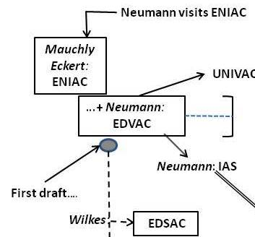
The birth of a design
1943
1944
1945
1946
1947
1948
1949
ENIAC, the first programmable electronic computer was launched in Feb 1946
Developers (Mauchly and Eckert) started design of an improved computer (EDVAC) in 1944
Neumann joined in Fall 1944, „commuting” from Los Alamos (~2000 miles)
Basic ideas (including stored program) worked out at regular (weekly) meetings of Mauchly, Eckert, Neumann, Goldstine, Burks…
Results summarized by Neumann (in letters from Los Alamos)
Split in the EDVAC team:
Mauchly and Eckert leaves Moore School in March 1946
Neumann continues with EDVAC and starts to build the IAS computer
Although EDVAC was completed and delivered to Aberdeen in 1948, official launch was delayed until 1951, so EDSAC became the first stored program electronic computer in the world

Slide 11
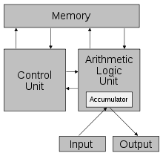
Significance of the „First Draft”
(Eckert-Mauchly: Progress Report on EDVAC, September 1945):
„He substituted physical structures and devices with idealized elements in order to avoid dealing with technical problems, which could distract our attention from the logical considerations.”
Swift from
„technology driven” design to
„logic driven” design
Definition and detailed description of the main units of the computer
(= „Neumann architecture”)
Definition of an instruction set and detailed logical description of the execution of the instructions
Originally intended to inside use, but later became widely distributed
(prevents patenting -> controversy)
Together with the plans of the IAS machine was used for designing many computers in the US and all over the world
= „IAS derivatives”

Slide 12
IAS derivatives
Plans for the IAS machine were widely distributed to any schools, businesses, or companies interested in computing machines, resulting in the construction of several derivative computers referred to as "IAS machines," although they were not software compatible in the modern sense. Some of these were:
AVIDAC (Argonne National Lab.)
BESK (Stockholm)
BESM (Moscow)
CYCLONE (Iowa State Univ.)
DASK (Copenhagen)
GEORGE (Argonne National Lab.)
IBM 701 (19 installations)
ILLIAC I (University of Illinois)
MUSASINO-1 (Tokyo, Japan)
JOHNNIAC (RAND)
MANIAC I (Los Alamos)
MISTIC (Michigan State Univ.)
ORACLE (Oak Ridge)
ORDVAC (Aberdeen)
PERM (Munich)
SARA (SAAB)
SEAC (Washington, DC)
SILLIAC (Univ. of Sydney)
SMIL (Lund Univ.)
WEIZAC (Israel)

Slide 13
View on the future of computers
Computer is for performing complicated scientific and technical calculations
Using computers for simpler („clerical”) tasks is a waste of computing power.
(even the use of programming tools, like assembler, programming languages was opposed as „useless”)
"My father … expected that the whole world wouldn't need more than a few, perhaps a dozen, computers, since their purpose was cutting-edge research with huge computational requirements.”
At that time:
no data processing by computers (electromechanical punched card machines)
no connectivity between computers
Neumann did not (could not) foresee the modern use of computers.
Nevertheless, consequences of some of his achievements (apart from the logical structure of computers), still have considerable effect in modern computer science.

Slide 14
Some results with present day impact
Neumann’s (postumus) paper on self-reproducing automata is referred to in many areas, including genetics (DNS structure), synthetic biology, artificial chemistry, spacecraft building etc.
3D printing opened the possibility to build a printer, being able to reproduce itself.
The theoretical foundation of building reliable systems from unreliable elements is equally important now, when our IT world is based on the organized cooperation of different interconnected services
“We are trying to prove the hypothesis: rapid prototyping and direct writing technologies are sufficiently versatile to allow them to be used to make a von Neumann Universal Constructor.”
RepRap project, Univ. Bath, UK 2005
"The trick is to make highly reliable systems out of unreliable components. John von Neumann... was the first to study this problem in the 1940s; in his time, computer parts were notoriously flaky.„
Jini, - system for distributed computing based on Java, 2001
Brain research is now in the center of interest of IT research, trying to simulate the operation of the brain and/or building computers with ideas borrowed from its structure. Neumann”s last (unfinished) work „The computer and the Brain” may serve as basis of both kind of considerations, outlining the similarities and differences between the operation of a computer and the (human) brain.

Slide 15
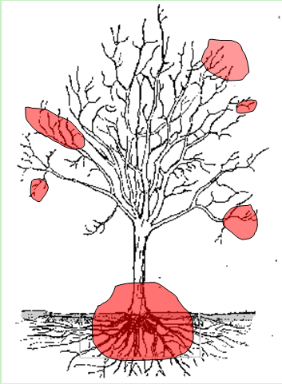
Conclusion
„Invention” of the electronic digital computer:
complex process with many players,
Neumann: logical design of the architecture (including stored program)
Still can be considered as basis of the modern world of computing, although with completely changed technologies, circumstances and applications
In his theoretical works - inspired by problems of computing – many significant ideas can be found, influencing present day research as well
Not only the root, but some leaves too
Last works of Neumann might be seen as building blocks of a general, mathematical theory of automata (and computing), which really can pretend to the title of
“A theory that transformed the world to a Cyberspace”

Slide 16
Thank you for your attention !
http://itf2.njszt.hu/objectum/Neumann_SMC2016
https://www.academia.edu/35388326/John_von_Neumann_in_Computer_Science

